Slide 1
GPS recap

Slide 2
Subjunctive form:
Usually a sentence that sounds particularly formal and usually uses the verbs were and be.
If I were to feel tired, I would have to rest.
Should I be hot tomorrow, I shall swim.

Slide 3
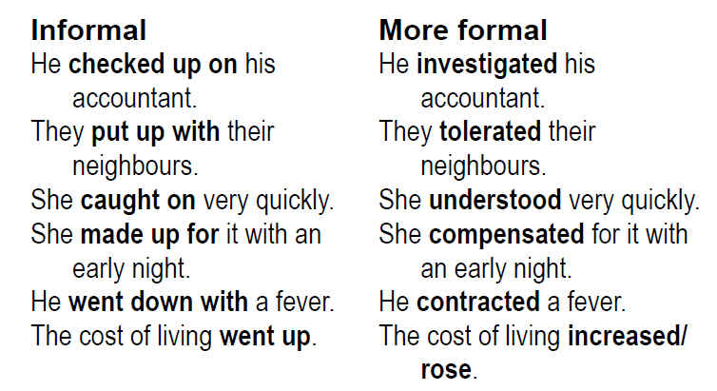
Formal VS informal

Slide 4
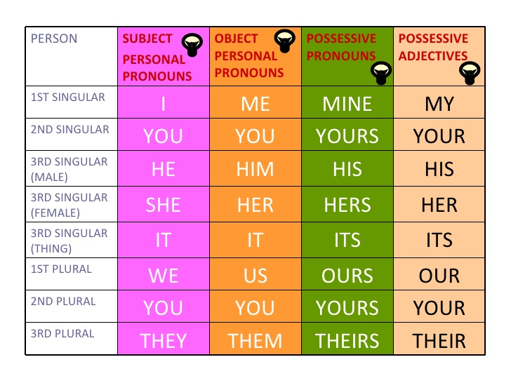
Pronouns:

Slide 5
Subject, verb and object!
http://stphilips-school.org/Grammar%20Pages/Grammar%20Presentations/Grammar%20Lesson%20=%20SUBJECTS%20&%20%20OBJECTS.pdf

Slide 6
Active and Passive

Slide 7
The dog was chewing the shoe.

Slide 8
The dog was chewing the shoe.
Circle the subject in this sentence.

Slide 9
The dog was chewing the shoe.
That’s right – the dog is the subject in this sentence.

Slide 10
The dog was chewing the shoe.
Now, find the verb and put a box around it.

Slide 11
The dog was chewing the shoe.
Have you drawn the box in the right place? Why is the box round both was and chewing?

Slide 12
The dog was actively chewing the shoe! So this is an sentence.
active
How could we change this sentence around?

Slide 13
The shoe was being chewed by the dog.
How have we changed this sentence around?

Slide 14
The shoe was being chewed by the dog.
Now circle the subject in this sentence.

Slide 15
The shoe was being chewed by the dog.
The shoe is now the subject of this sentence.

Slide 16
The shoe was being chewed by the dog.
Where is the verb in this sentence?
Draw a rectangle around the verb.

Slide 17
The shoe was being chewed by the dog.
Did you get it right? What is happening to the shoe?

Slide 18
The shoe was being chewed by the dog.
passive
This is a sentence. The subject-the shoe is not doing anything, it is ‘passively’ having something done to it. It is being chewed!

Slide 19
Is this sentence active or passive?
Sarah was drawing a picture.

Slide 20
active

Slide 21
Sarah was drawing an picture.
That’s right! This sentence is active. Sarah is actively drawing the picture.

Slide 22
The window was broken by Kelly.
Is this sentence active or passive?

Slide 23
passive

Slide 24
The window was broken by Kelly.
Well done! This sentence is passive. The subject of the sentence is the window. The window had something done to it – Kelly broke it!

Slide 25
Present perfect
have/has been and the -ing
They’ve been married for nearly fifty years. She has lived in Liverpool all her life.
She has been living in Liverpool all her life. It’s been raining for hours.
I’ve played the guitar ever since I was a teenager. He has written three books and he is working on another one. I’ve been watching that programme every week.
They’ve been staying with us since last week. I have worked here since I left school.

